Slide 1
Joining Forces Steering Committee Data Update
Brenda Buescher, MPH Data Manager, Lancaster County Joining Forces
Health Promotion Specialist, Penn Medicine Lancaster General Health
January 23, 2024

Slide 2
Annual Overdose Deaths in Lancaster County, 2013-present
Updated: January 8, 2024 Sources: Pennsylvania Department of Health Office of Drug Surveillance; Lancaster County Coroner’s Office *Note: Data is subject to change and based on reports available to date. Coroner’s reports may take 3-6 months to appear in reported data.
Notes:
Most recent reported deaths are from December.

Slide 3
Substances Found in OD Deaths
Source: Lancaster County Coroner’s Office, updated 1/23/24

Slide 4
National, State, Local Comparison
Source: CDC WONDER, reviewed 1/8/24

Slide 5
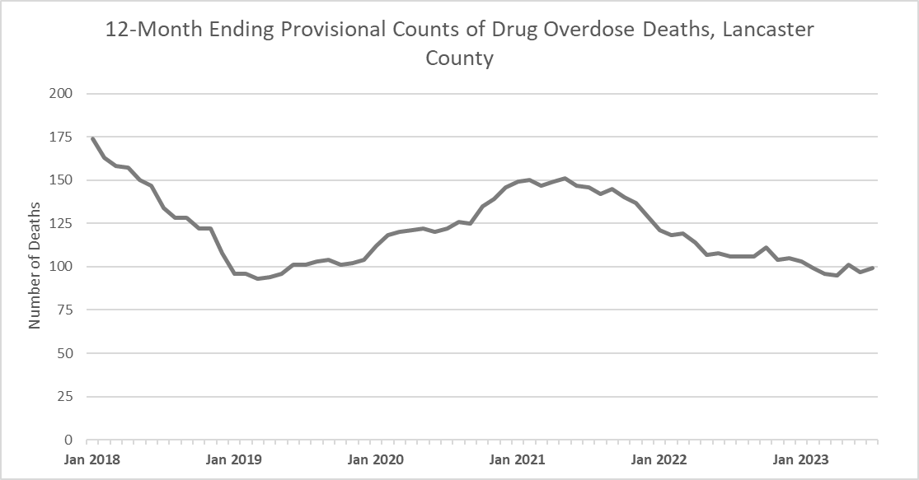
Drug Overdose Deaths, Lancaster County
Source: Lancaster County Coroner’s Office

Slide 6
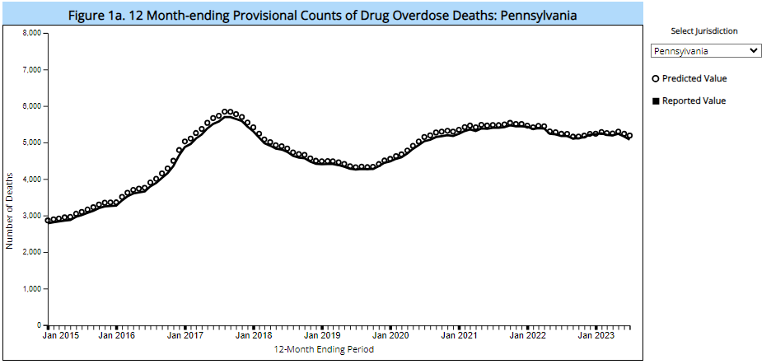
Drug Overdose Deaths, Pennsylvania
Source: CDC Provisional Drug Overdose Death Counts, accessed 1/8/24

Slide 7
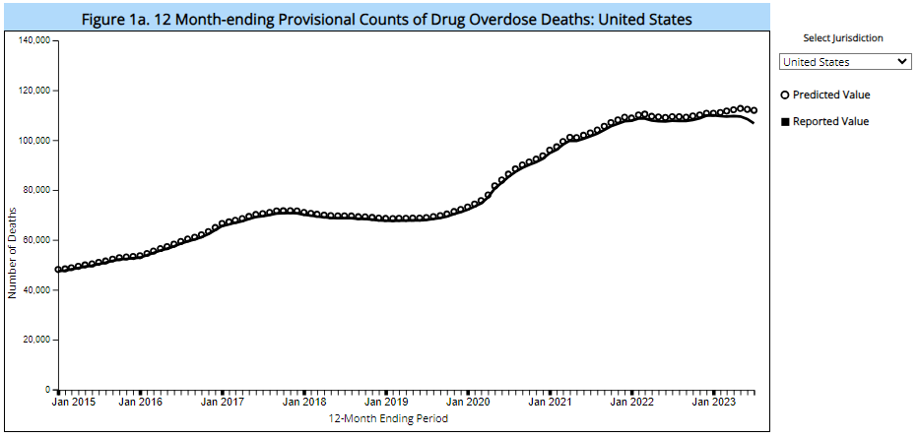
Drug Overdose Deaths, United States
Source: CDC Provisional Drug Overdose Death Counts, accessed 1/8/2024

Slide 8
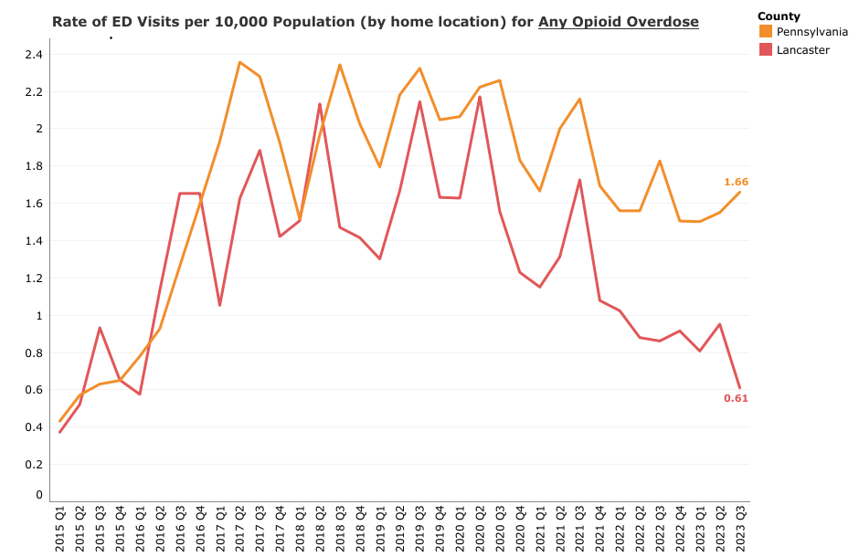
Emergency Department Visits for Opioid Overdose
Source: Pennsylvania ODSMP: Drug Overdose Surveillance Interactive Data Report

Slide 9
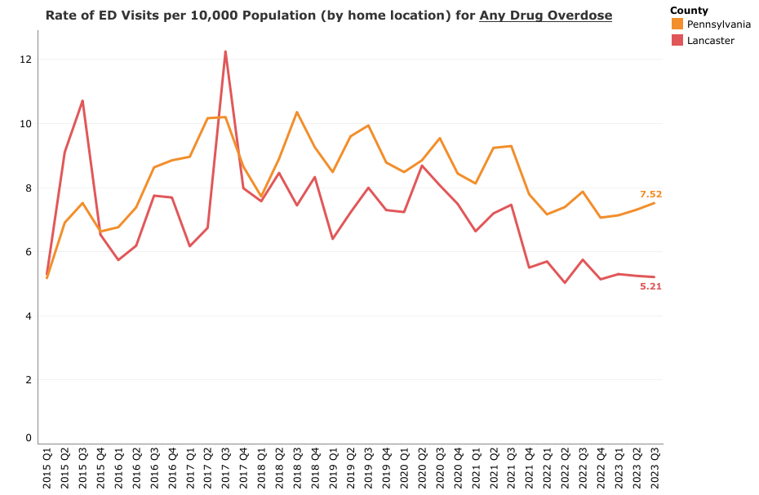
Emergency Department Visits for All Drug Overdoses
Source: Pennsylvania ODSMP: Drug Overdose Surveillance Interactive Data Report

Slide 10
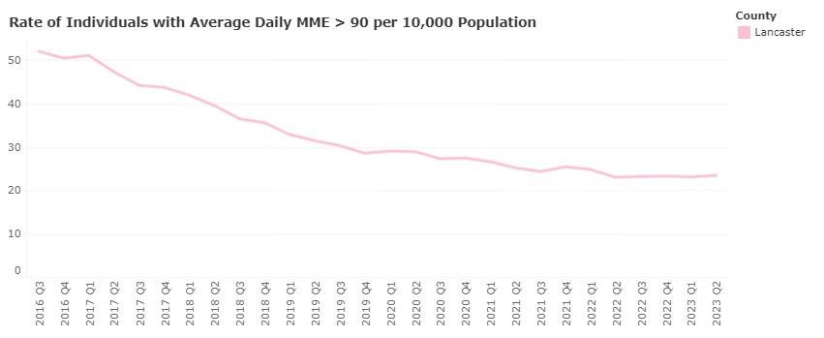
Decrease in Risky Prescribing Practices
52 per 10,000
24 per 10,000
Source: Pennsylvania ODSMP: Drug Overdose Surveillance Interactive Data Report
Notes:
55% decrease from 2016 – 2023.

Slide 11
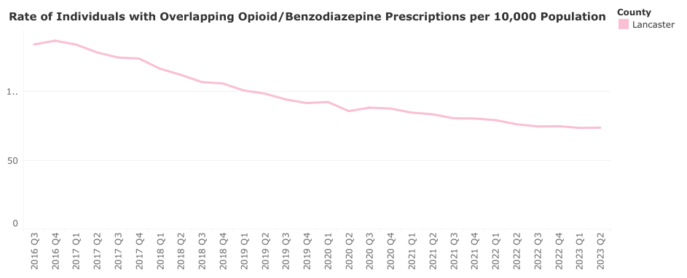
Decrease in Risky Prescribing Practices
137 per 10,000
100
73 per 10,000
Source: Pennsylvania ODSMP: Drug Overdose Surveillance Interactive Data Report
Notes:
45% decrease from 2016-2023.

Slide 12
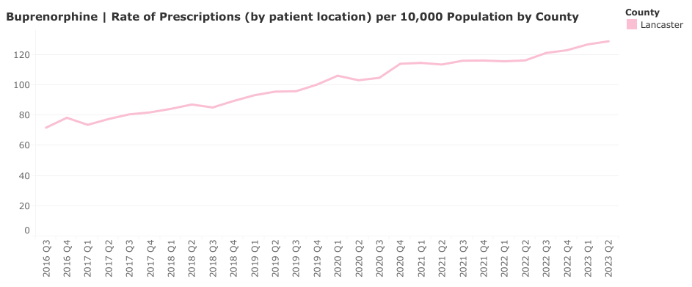
Increasing Use of Medication for Opioid Use Disorder
129 per 10,000
72 per 10,000
Source: Pennsylvania ODSMP: Drug Overdose Surveillance Interactive Data Report

